Slide 1
Cloud Excellence Presentation
Team Flashcard Learners
Members:
Alvino Villa, Mateusz Marciszewski, Paramjeet Bindra, Steve Tu
Notes:
Matt

Slide 2
Deploying a Flashcard Application on AWS
Project Overview
Business Value
Tools/Software Environment used
Architecture/Design diagram
Challenges/Issues/Problems/Your stories
What have you learned/learned?
What else can we do on the project? - future plan- any design and implementation ideas?
Demo
Questions and answers
Notes:
Matt
steve change this***

Slide 3
Business Value:
A flash card study aid for leveraging technology by giving users the opportunity to update a single file to help them with their studies.
example: AWS concepts and their explanations
example 2: teaching new hires about Booz Allen Hamilton’s values
By choosing this you can actually fork the repo to use it as a design study tool and multiple people could be making flashcards.
Notes:
Matts

Slide 4
Technologies and Environment used
*Primary Project:
- Github
– AWS Pipeline
- AWS CodeBuild
- Elastic Kubernetes Service (EKS)
- Elastic Container Registry (ECR)
- AWS (SNS) Simple Notification Service
- AWS Lambda
*Backup Project:
- Github
- AWS Pipeline
- AWS (SNS) Simple Notification Service
- AWS Lambda
- AutoScalingGroup
Other Services: -CloudFormation, IAM, S3
Notes:
*Steve Slide
So for our project, we actually figured out 2 ways to do it.
My teammates first developed up a baseline project, in which I’ll call it the backup project in this slide.
– The purpose of it was to have something up and running; due to time constraints.
For that project, we used the components of:
Github: to host the code
AWS Pipeline: to pull the code and deploy to AWS S3*
AWS SNS: to notify Lambda of code updates
AWS Lambda: to start instance refresh of an Autoscaling group
and then *AutoScalingGroup: rolling updates using a launch template to deliver new code – As for the *Primary Project: the differences in this project is that we used: EKS, ECR, and CodeBuild
AWS CodeBuild: to build new container image and pushes to ECR, CodeBuild is running the update
AWS Elastic Container Service (ECS): allows to deploy virtual servers within AWS Cloud environment. It requires some form of ECS Instance running within their environment as a part of at least one of their solutions
Elastic Kubernetes Service (EKS):is a managed Kubernetes service to run Kubernetes in the AWS cloud. It manages the performance, scale, reliability, and availability of AWS infrastructure
Elastic Container Registry (ECR): AWS managed container image registry service that is secure, scalable, and reliable. Amazon ECR supports private repositories with resource-based permissions using AWS IAM.
Other Services:
we used was CloudFormation to look at templates to create EKS VPC, and as well as IAM and S3
and now I’ll pass it to Paramjeet*

Slide 5
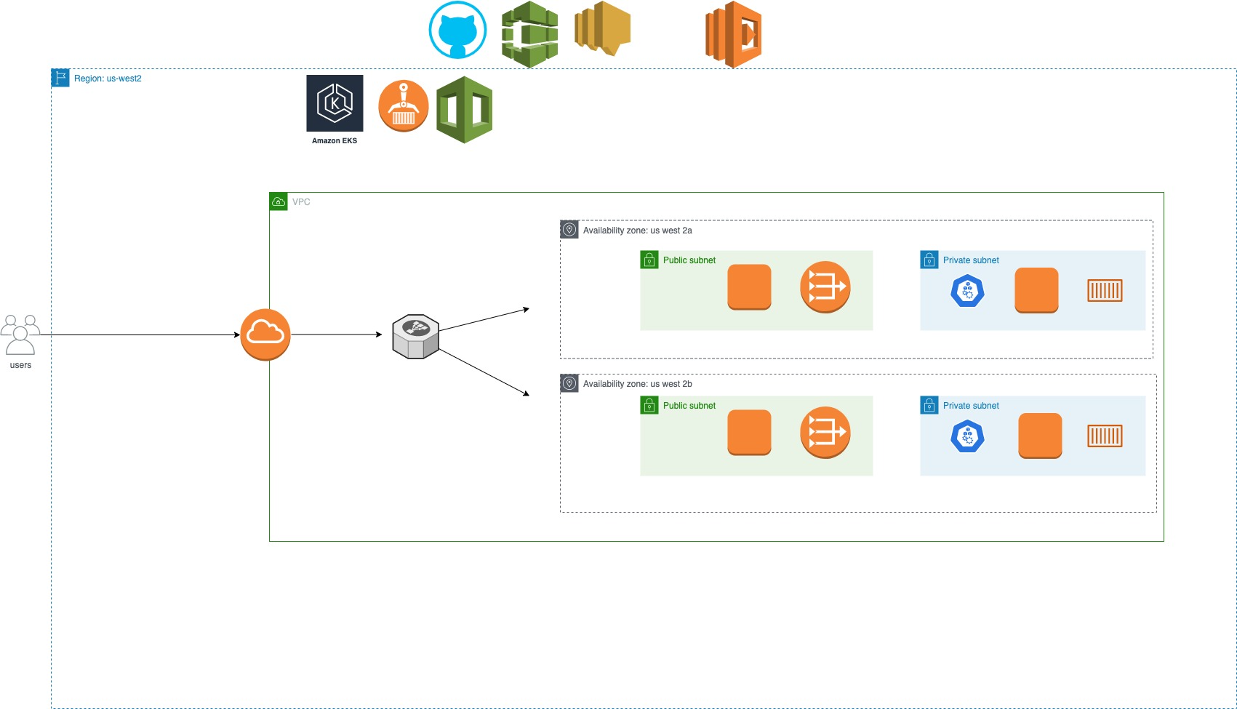
Primary Project: Architecture and Design
Notes:
Paramjeet

Slide 6


(EKS) Elastic Kubernetes Service vs (ECS) Elastic Container Service
Components | EKS | ECS
Open Source | Yes! | No! AWS proprietary
Multi Cloud Integration | Yes! Public & Private | AWS specific
Community Support | Yes | Less
Security | Does not support IAM | Supports IAM roles
Simplicity vs Flexibility | Difficult | Easy
Pricing | Expensive | Less expensive
Portability | Better | AWS specific
Notes:
Paramjeet Kubernetes is open source and ECS is AWS proprietary
Kubernetes is multi cloud integration ECS is AWS specific. ECS is pay on demand
More community support for Kubernetes. Kubernetes supports high number of pods on a single VM
ECS supports IAM security, Kuber does not
ECS is easy deployment compared to Kubernetes
EKS: considering deploying containers across multiple infrastructures and would like to take advantage of Kubernetes’ flexibility,
: Looking for a more future-proof and versatile approach, EKS is the ideal choice
ECS: if you’re looking to work exclusively on AWS
: Organizations with limited expertise and insufficient resources to invest in learning Kubernetes
: Ideal choice when there is no time to build, deploy, or migrate your containerized applications
Pricing: EKS is more expensive then ECS.
Security: ECS is deeply integrated with IAM, enabling customers to assign granular access
permissions for each container and using IAM to restrict access to each service.Better than EKS

Slide 7
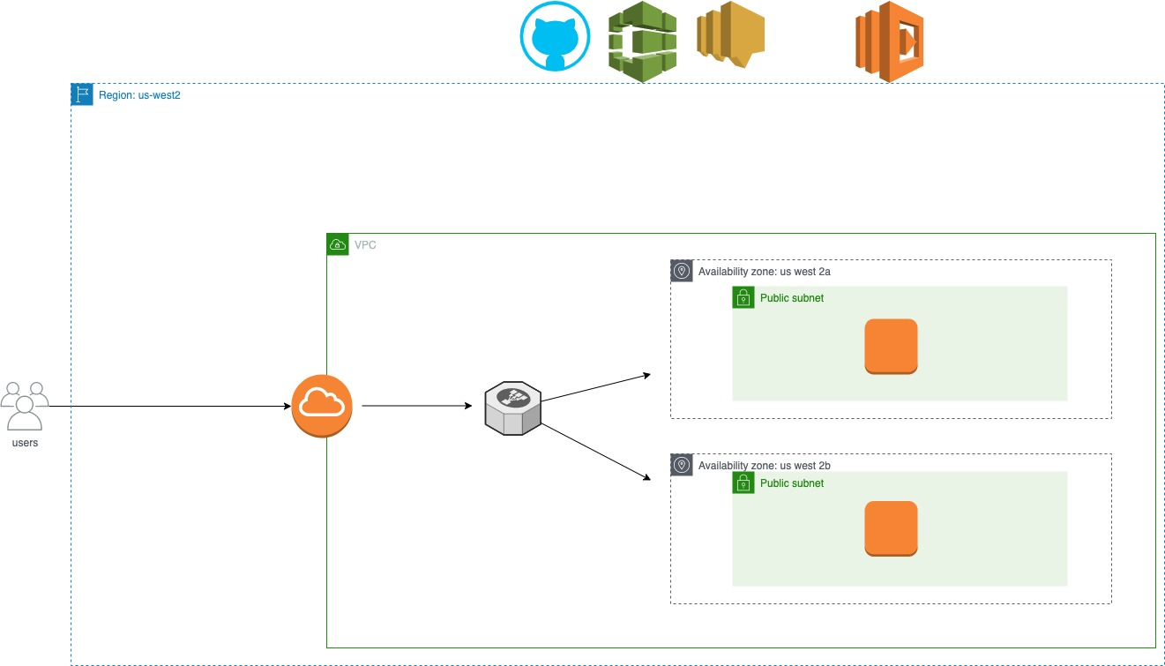
Backup Project: Architecture and Design
Notes:
Al’s slide

Slide 8
Challenges and Issues* from our personal team
Challenges:
Choosing a particular CI/CD method
Deciding between ECS/EKS and why?
Determining backup plan/project.
Issues:
Challenges with timely AWS ECR updates
AWS Pipeline kicking off instance rollout
Having two containers and only one was able to run and the other did not
Deployed (ALB) Application Load Balancer and only one node was healthy; we didn’t get true load balancing
AWS Pipeline deploy stage, Lambda function not telling the pipeline it was done
AWS IAM role policy issue with Lambda ‘get’ and ‘pass’ EC2 role
Notes:
Al’s

Slide 9

Demo
Notes:
we are recording the demo tomorrow****

Slide 10
Future State - What we would add
-Host the app using (ECS)
-use of Application Load Balancers (ALB)
-to be more *cost efficient*; knowing the real world impact with the things we are playing around with
-being able to deploy to another region
-remove SNS to Lambda dependency
- local cron to rotate multiple index.html
Notes:
Steve Slide
so basically this is the next to last slide
Things we look forward to doing in the future:
-host the app using (Elastic Container Service)
-use of Application Load Balancers (ALB)
-to be more *cost efficient*; knowing the real world impact with the things we are playing around with
-being able to deploy to another region
-remove SNS to Lambda dependency
- have a local cron to rotate multiple index.html
– get it updated’Steve****

Slide 11
Q & A - Ask us anything
Notes:
Marc will get the last slide

